Slide 1
Graph & BFS
Lecture 1

Slide 2
Graphs
Extremely useful tool in modeling problems
Consist of:
  Vertices
  Edges
Vertices can be
considered “sites”
or locations.
Edges represent
connections.
D
E
C
A
F
B
Vertex
Edge

Slide 3
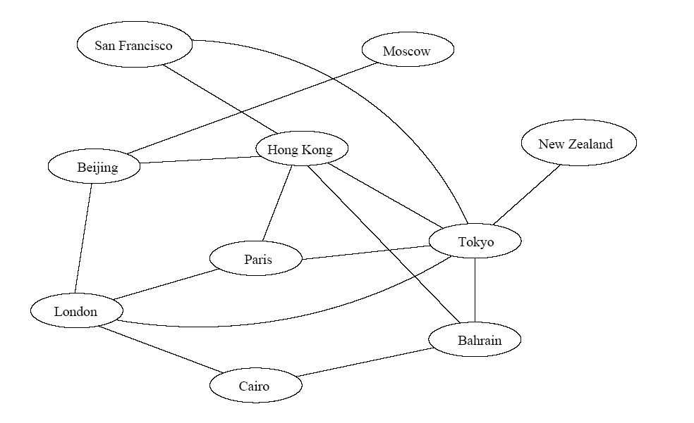
Application
Air flight system
Each vertex represents a city
Each edge represents a direct flight between two cities
A query on direct flights = a query on whether an edge exists
A query on how to get to a location = does a path exist from A to B
We can even associate costs to edges (weighted graphs), then ask “what is the cheapest path from A to B”

Slide 4
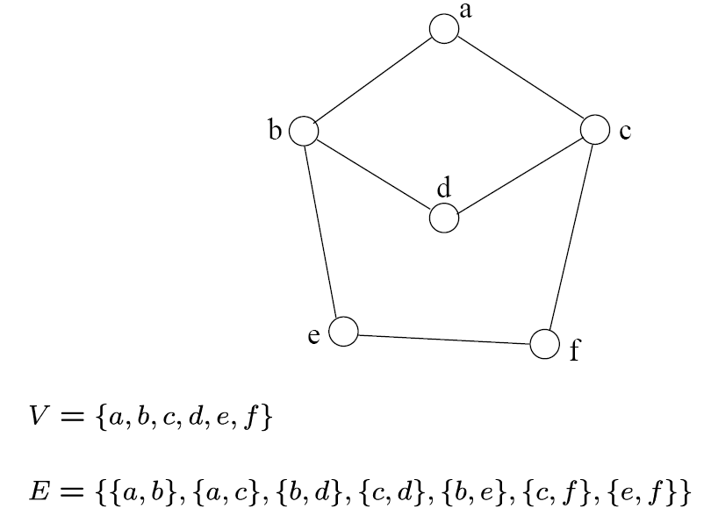
Definition
A graph G=(V, E) consists a set of vertices, V, and a set of edges, E.
Each edge is a pair of (v, w), where v, w belongs to V
If the pair is unordered, the graph is undirected; otherwise it is directed
{a,b}
{a,c}
{b,d}
{c,d}
{b,e}
{c,f}
{e,f}
An undirected graph

Slide 5
Definition
Complete Graph
  How many edges are there in an N-vertex complete graph?
Bipartite Graph
  What is its property? How can we detect it?
Path
Tour
Degree of a vertices
  Indegree
  Outdegree
  Indegree+outdegree = Even (why??)

Slide 6
Graph Variations
Variations:
  A connected graph has a path from every vertex to every other
  In an undirected graph:
    Edge (u,v) = edge (v,u)
    No self-loops
  In a directed graph:
    Edge (u,v) goes from vertex u to vertex v, notated u→v

Slide 7
Graph Variations
More variations:
  A weighted graph associates weights with either the edges or the vertices
    E.g., a road map: edges might be weighted w/ distance
  A multigraph allows multiple edges between the same vertices
    E.g., the call graph in a program (a function can get called from multiple points in another function)

Slide 8
Graphs
We will typically express running times in terms of |E| and |V| (often dropping the |’s)
  If |E| ≈ |V|² the graph is dense
  If |E| ≈ |V| the graph is sparse
If you know you are dealing with dense or sparse graphs, different data structures may make sense

Slide 9
Graph Representation
Two popular computer representations of a graph. Both represent the vertex set and the edge set, but in different ways.
  Adjacency Matrix
    Use a 2D matrix to represent the graph
  Adjacency List
    Use a 1D array of linked lists

Slide 10
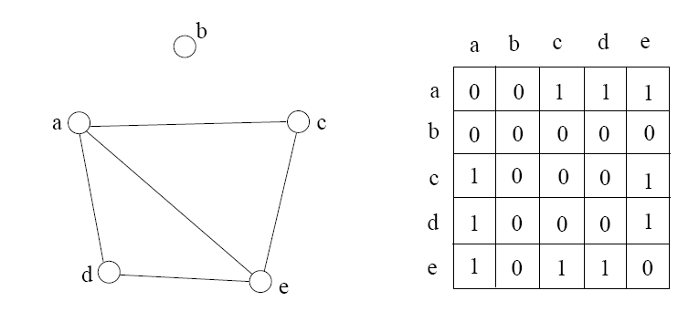
Adjacency Matrix
2D array A[0..n-1, 0..n-1], where n is the number of vertices in the graph
Each row and column is indexed by the vertex id
  e,g a=0, b=1, c=2, d=3, e=4
A[i][j]=1 if there is an edge connecting vertices i and j; otherwise, A[i][j]=0
The storage requirement is Θ(n²). It is not efficient if the graph has few edges. An adjacency matrix is an appropriate representation if the graph is dense: |E|=Θ(|V|²)
We can detect in O(1) time whether two vertices are connected.

Slide 11
Simple Questions on Adjacency Matrix
Is there a direct link between A and B?
What is the indegree and outdegree for a vertex A?
How many nodes are directly connected to vertex A?
Is it an undirected graph or directed graph?
Suppose ADJ is an NxN matrix. What will be the result if we create another matrix ADJ2 where ADJ2=ADJxADJ?

Slide 12
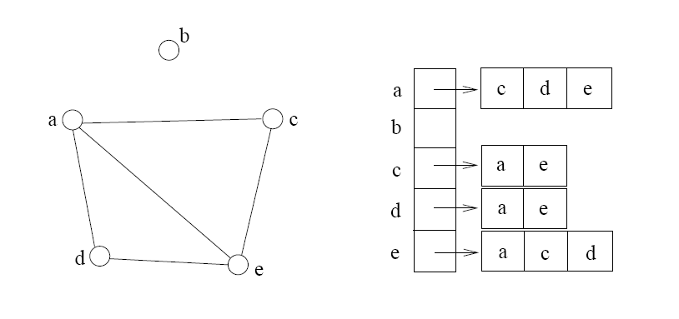
Adjacency List
If the graph is not dense, in other words, sparse, a better solution is an adjacency list
The adjacency list is an array A[0..n-1] of lists, where n is the number of vertices in the graph.
Each array entry is indexed by the vertex id
Each list A[i] stores the ids of the vertices adjacent to vertex i

Slide 13
Adjacency Matrix Example
0
 | 0 | 1 | 2 | 3 | 4 | 5 | 6 | 7 | 8 | 9
0 | 0 | 0 | 0 | 0 | 0 | 0 | 0 | 0 | 1 | 0
1 | 0 | 0 | 1 | 1 | 0 | 0 | 0 | 1 | 0 | 1
2 | 0 | 1 | 0 | 0 | 1 | 0 | 0 | 0 | 1 | 0
3 | 0 | 1 | 0 | 0 | 1 | 1 | 0 | 0 | 0 | 0
4 | 0 | 0 | 1 | 1 | 0 | 0 | 0 | 0 | 0 | 0
5 | 0 | 0 | 0 | 1 | 0 | 0 | 1 | 0 | 0 | 0
6 | 0 | 0 | 0 | 0 | 0 | 1 | 0 | 1 | 0 | 0
7 | 0 | 1 | 0 | 0 | 0 | 0 | 1 | 0 | 0 | 0
8 | 1 | 0 | 1 | 0 | 0 | 0 | 0 | 0 | 0 | 1
9 | 0 | 1 | 0 | 0 | 0 | 0 | 0 | 0 | 1 | 0
8
2
9
1
3
7
6
4
5

Slide 14
Adjacency List Example
0
0
1
2
3
4
5
6
7
8
9
8
2 | 3 | 7 | 9
8
1 | 4 | 8
2
9
1 | 4 | 5
1
2 | 3
7
3 | 6
3
6
5 | 7
4
5
1 | 6
0 | 2 | 9
1 | 8

Slide 15
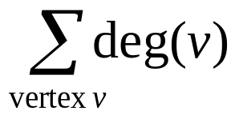
Storage of Adjacency List
The array takes up Θ(n) space
Define degree of v, deg(v), to be the number of edges incident to v. Then, the total space to store the graph is proportional to:
An edge e={u,v} of the graph contributes a count of 1 to deg(u) and contributes a count 1 to deg(v)
Therefore, Σ_{vertex v}deg(v) = 2m, where m is the total number of edges
In all, the adjacency list takes up Θ(n+m) space
  If m = O(n²) (i.e. dense graphs), both adjacent matrix and adjacent lists use Θ(n²) space.
  If m = O(n), adjacent list outperform adjacent matrix
However, one cannot tell in O(1) time whether two vertices are connected

Slide 16
Adjacency List vs. Matrix
Adjacency List
  More compact than adjacency matrices if graph has few edges
  Requires more time to find if an edge exists
Adjacency Matrix
  Always require n² space
    This can waste a lot of space if the number of edges are sparse
  Can quickly find if an edge exists

Slide 17
Path between Vertices
A path is a sequence of vertices (v₀, v₁, v₂,… v_{k}) such that:
  For 0 ≤ i < k, {v_{i}, v_{i+1}} is an edge
  Note: a path is allowed to go through the same vertex or the same edge any number of times!
The length of a path is the number of edges on the path

Slide 18

Types of paths
A path is simple if and only if it does not contain a vertex more than once.
A path is a cycle if and only if v₀= v_{k}
    The beginning and end are the same vertex!
A path contains a cycle as its sub-path if some vertex appears twice or more

Slide 19
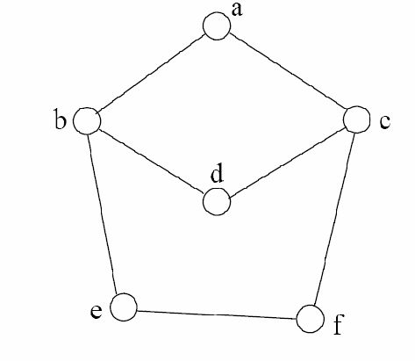
Path Examples
Are these paths?
Any cycles?
What is the path’s length?
{a,c,f,e}
{a,b,d,c,f,e}
{a, c, d, b, d, c, f, e}
{a,c,d,b,a}
{a,c,f,e,b,d,c,a}

Slide 20
Graph Traversal
Application example
  Given a graph representation and a vertex s in the graph
  Find paths from s to other vertices
Two common graph traversal algorithms
    Breadth-First Search (BFS)
      Find the shortest paths in an unweighted graph
    Depth-First Search (DFS)
      Topological sort
      Find strongly connected components

Slide 21
BFS and Shortest Path Problem
Given any source vertex s, BFS visits the other vertices at increasing distances away from s. In doing so, BFS discovers paths from s to other vertices
What do we mean by “distance”? The number of edges on a path from s
Example
0
Consider s=vertex 1
8
2
Nodes at distance 1?
2, 3, 7, 9
1
2
s
9
1
1
Nodes at distance 2?
8, 6, 5, 4
7
1
3
6
2
4
1
5
Nodes at distance 3?
0
2
2

Slide 22
Graph Searching
Given: a graph G = (V, E), directed or undirected
Goal: methodically explore every vertex and every edge
Ultimately: build a tree on the graph
  Pick a vertex as the root
  Choose certain edges to produce a tree
  Note: might also build a forest if graph is not connected

Slide 23
Breadth-First Search
“Explore” a graph, turning it into a tree
  One vertex at a time
  Expand frontier of explored vertices across the breadth of the frontier
Builds a tree over the graph
  Pick a source vertex to be the root
  Find (“discover”) its children, then their children, etc.

Slide 24
Breadth-First Search
Every vertex of a graph contains a color at every moment:
  White vertices have not been discovered
    All vertices start with white initially
  Grey vertices are discovered but not fully explored
    They may be adjacent to white vertices
  Black vertices are discovered and fully explored
    They are adjacent only to black and gray vertices
Explore vertices by scanning adjacency list of grey vertices

Slide 25
Breadth-First Search: The Code
Data: color[V], prev[V],d[V]
BFS(G) // starts from here
{
for each vertex u ∈ V-{s}
{
color[u]=WHITE;
prev[u]=NIL;
d[u]=inf;
}
color[s]=GRAY;
d[s]=0; prev[s]=NIL;
Q=empty;
ENQUEUE(Q,s);
While(Q not empty)
{
u = DEQUEUE(Q);
for each v ∈ adj[u]{
if (color[v] == WHITE){
color[v] = GREY;
d[v] = d[u] + 1;
prev[v] = u;
Enqueue(Q, v);
}
}
color[u] = BLACK;
}
}

Slide 26
Breadth-First Search: Example
r
s
t
u
∞
∞
∞
∞
∞
∞
∞
∞
v
w
x
y
Vertex | r | s | t | u | v | w | x | y
color | W | W | W | W | W | W | W | W
d | ∞ | ∞ | ∞ | ∞ | ∞ | ∞ | ∞ | ∞
prev | nil | nil | nil | nil | nil | nil | nil | nil

Slide 27
Breadth-First Search: Example
r
s
t
u
∞
0
∞
∞
∞
∞
∞
∞
v
w
x
y
Q:
s
vertex | r | s | t | u | v | w | x | y
Color | W | G | W | W | W | W | W | W
d | ∞ | 0 | ∞ | ∞ | ∞ | ∞ | ∞ | ∞
prev | nil | nil | nil | nil | nil | nil | nil | nil

Slide 28
Breadth-First Search: Example
r
s
t
u
1
0
∞
∞
∞
1
∞
∞
v
w
x
y
Q:
s
w
r
vertex | r | s | t | u | v | w | x | y
Color | G | B | W | W | W | G | W | W
d | 1 | 0 | ∞ | ∞ | ∞ | 1 | ∞ | ∞
prev | s | nil | nil | nil | nil | s | nil | nil

Slide 29
Breadth-First Search: Example
r
s
t
u
1
0
2
∞
∞
1
2
∞
v
w
x
y
Q:
s
w
r
t
x
vertex | r | s | t | u | V | w | X | y
Color | G | B | G | W | W | B | G | W
d | 1 | 0 | 2 | ∞ | ∞ | 1 | 2 | ∞
prev | s | nil | w | nil | nil | s | w | nil

Slide 30
Breadth-First Search: Example
r
s
t
u
1
0
2
∞
2
1
2
∞
v
w
x
y
Q:
s
w
r
t
x
v
vertex | r | s | t | u | v | w | x | y
Color | B | B | G | W | G | B | G | W
d | 1 | 0 | 2 | ∞ | 2 | 1 | 2 | ∞
prev | s | nil | w | nil | r | s | w | nil

Slide 31
Breadth-First Search: Example
r
s
t
u
1
0
2
3
2
1
2
∞
v
w
x
y
Q:
s
w
r
t
x
v
u
vertex | r | s | t | u | v | w | x | y
Color | B | B | B | G | G | B | G | W
d | 1 | 0 | 2 | 3 | 2 | 1 | 2 | ∞
prev | s | nil | w | t | r | s | w | nil

Slide 32
Breadth-First Search: Example
r
s
t
u
1
0
2
3
2
1
2
3
v
w
x
y
Q:
s
w
r
t
x
v
u
y
vertex | r | s | t | u | v | w | x | y
Color | B | B | B | G | G | B | B | G
d | 1 | 0 | 2 | 3 | 2 | 1 | 2 | 3
prev | s | nil | w | t | r | s | w | x

Slide 33
Breadth-First Search: Example
r
s
t
u
1
0
2
3
2
1
2
3
v
w
x
y
Q:
s
w
r
t
x
v
u
y
vertex | r | s | t | u | v | w | x | y
Color | B | B | B | G | B | B | B | G
d | 1 | 0 | 2 | 3 | 2 | 1 | 2 | 3
prev | s | nil | w | t | r | s | w | x

Slide 34
Breadth-First Search: Example
r
s
t
u
1
0
2
3
2
1
2
3
v
w
x
y
Q:
s
w
r
t
x
v
u
y
vertex | r | s | t | u | v | w | x | y
Color | B | B | B | B | B | B | B | G
d | 1 | 0 | 2 | 3 | 2 | 1 | 2 | 3
prev | s | nil | w | t | r | s | w | x

Slide 35
Breadth-First Search: Example
r
s
t
u
1
0
2
3
2
1
2
3
v
w
x
y
Q:
s
w
r
t
x
v
u
y
vertex | r | s | t | u | v | w | x | y
Color | B | B | B | G | B | B | B | B
d | 1 | 0 | 2 | 3 | 2 | 1 | 2 | 3
prev | s | nil | w | t | r | s | w | x

Slide 36
BFS: The Code (again)
Data: color[V], prev[V],d[V]
BFS(G) // starts from here
{
for each vertex u ∈ V-{s}
{
color[u]=WHITE;
prev[u]=NIL;
d[u]=inf;
}
color[s]=GRAY;
d[s]=0; prev[s]=NIL;
Q=empty;
ENQUEUE(Q,s);
While(Q not empty)
{
u = DEQUEUE(Q);
for each v ∈ adj[u]{
if (color[v] == WHITE){
color[v] = GREY;
d[v] = d[u] + 1;
prev[v] = u;
Enqueue(Q, v);
}
}
color[u] = BLACK;
}
}

Slide 37
Breadth-First Search: Print Path
Data: color[V], prev[V],d[V]
Print-Path(G, s, v)
{
if(v==s)
print(s)
else if(prev[v]==NIL)
print(No path);
else{
Print-Path(G,s,prev[v]);
print(v);
}
}

Slide 38
Amortized Analysis
Stack with 3 operations:
  Push, Pop, Multi-pop
What will be the complexity if “n” operations are performed?

Slide 39
BFS: Complexity
Data: color[V], prev[V],d[V]
BFS(G) // starts from here
{
for each vertex u ∈ V-{s}
{
color[u]=WHITE;
prev[u]=NIL;
d[u]=inf;
}
color[s]=GRAY;
d[s]=0; prev[s]=NIL;
Q=empty;
ENQUEUE(Q,s);
While(Q not empty)
{
u = DEQUEUE(Q);
for each v ∈ adj[u]{
if(color[v] == WHITE){
color[v] = GREY;
d[v] = d[u] + 1;
prev[v] = u;
Enqueue(Q, v);
}
}
color[u] = BLACK;
}
}
u = every vertex, but only once
(Why?)
O(V)
O(V)
What will be the running time?
Total running time: O(V+E)

Slide 40
Breadth-First Search: Properties
BFS calculates the shortest-path distance to the source node
  Shortest-path distance δ(s,v) = minimum number of edges from s to v, or ∞ if v not reachable from s
  Proof given in the book (p. 472-5)
BFS builds breadth-first tree, in which paths to root represent shortest paths in G
  Thus can use BFS to calculate shortest path from one vertex to another in O(V+E) time

Slide 41
Application of BFS
Find the shortest path in an undirected/directed unweighted graph.
Find the bipartiteness of a graph.
Find cycle in a graph.
Find the connectedness of a graph.

Slide 42
Books
Cormen – Chapter 22 – elementary Graph Algorithms
Exercise you have to solve:
  22.1-5 (Square)
  22.1-6 (Universal Sink)
  22.2-6 (Wrestler)
  22.2-7 (Diameter)
  22.2-8 (Traverse)

